Slide 1


Slide 2






ALIF
The First
An Intelligent HR Assistant

Slide 3
Our Team
Muqeet A.
Abdullah A.
Usman Ali
Sadia J.
Abdullah F.
Member
Member
Supervisor
Scrum Master
Member

Slide 4
Extracted from proposal
Labor force growth
Problem Statement
Current HR processes are inefficient, with qualified candidates often overlooked due to manual resume screening and time-intensive interview processes.
While existing AI solutions are limited to basic chatbots, there's a need for human-like interaction and end-to-end systems that can handle multiple HR tasks efficiently while keeping user trust in view.
(Further details are added into Proposal)
Notes:
Need to add sources

Slide 5
Opportunities and Challenges
70%
30%
15%
47%
Fresh graduates in IT sector find a job within first 6 months
Annual growth is observed in IT and digital services
Increase in demand for skilled HR professionals
Candidates are hired due to favoritism
Notes:
Need to add sources

Slide 6
Recruitment Metrics (Pakistan)
1.84M +
1.51M +
173M +
Job openings / year
Employees hired / year
Applications processed H1-2024
> 1 Month
30B +
1/2 Hour
Average hiring process / job
Spent in HR salaries / year
Average interview time
Notes:
Need to add sources

Slide 7
ALIF
Introducing

Slide 8
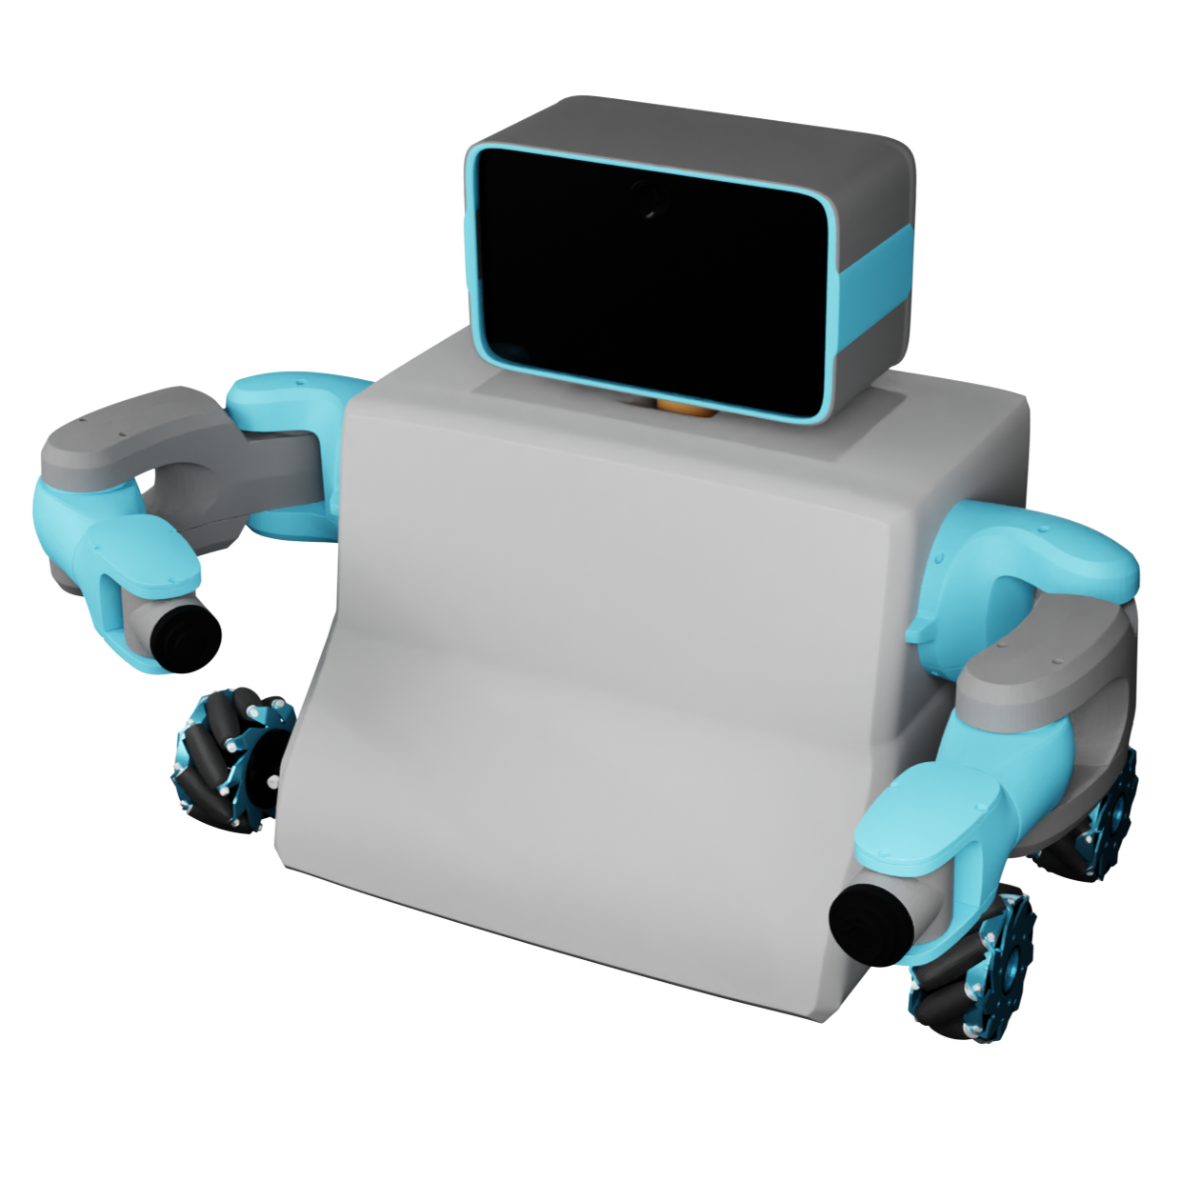
ALIF
An Intelligent HR assistant that can:
Screen & analyze resumes
Take interviews
Generate interview reports
Interact with candidates
Observe its surroundings
Show gestures and expressions

Slide 9
The Adoption and Effect of Artificial Intelligence on Human Resources Management, Part A
Emerald | DOI: 10.1108/978-1-80382-027-920231015
Artificial Intelligence Reshaping Human Resource Management : A Review
IEEE | DOI: 10.1109/ICATMRI51801.2020.9398420
Literature Review
ALIF has Modular Design for Versatility
While existing systems might focus on fixed functionalities, ALIF's ability to adapt its tasks due to its modular structure is a significant innovation.
The plug-and-play design is considered a novel approach for scalability and flexibility.

Slide 10
The Adoption and Effect of Artificial Intelligence on Human Resources Management, Part A
Emerald | DOI: 10.1108/978-1-80382-027-920231015
AI-HRM: Artificial Intelligence in Human Resource
Management: A Literature Review Journal of Computing and Communication | Vol.2 , No.2 , PP. 1-7 , 2023
Literature Review
ALIF promotes Human-Like Interaction
ALIF incorporates following features to improve user trust and engagement:
Face expressions
Voice communication
Limb Movement
These feature go beyond the typical virtual assistants seen in HR automation systems by aligning more closely with human interaction needs.

Slide 11
AI-HRM: Artificial Intelligence in Human Resource
Management: A Literature Review Journal of Computing and Communication | Vol.2 , No.2 , PP. 1-7 , 2023
Literature Review
End-to-End HR System
Unlike systems that focus solely on resume screening or candidate recommendations, ALIF offers end-to-end HR automation including:
Resume analysis
Physical interaction
Interviewing (both technical and personality-based)
Report generation

Slide 12


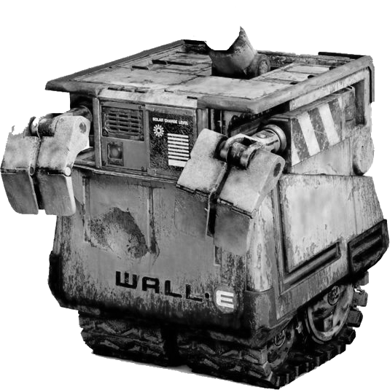

Motivation
Our motivation mainly comes from the facts and information about the current situation of industry.
We are motivated to present our solution as a robot which not only can be trained to do interviews but can also be trained on general tasks for other industries.
We propose to revolutionize the industry with our generalized system which can have its use-case in multiple domains.

Slide 13


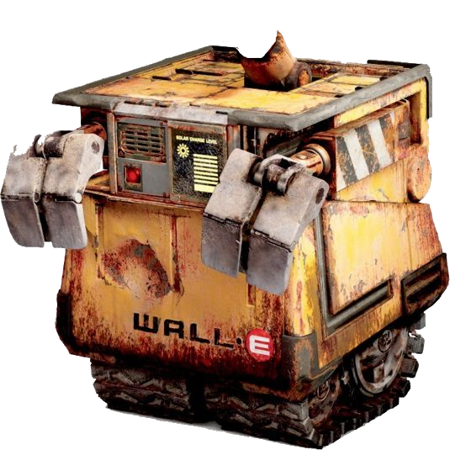
Motivation
Wall-E
Wall-E is an AI robot from a Pixar movie – the concept for robotic body.

Slide 14

Motivation
EMO Bot
EMO, designed by LivingAI, is an AI pet robot which has a personality.

Slide 15

A look at the
Software
Structure

Slide 16

Software
The main idea
of ALIF
System
We will use a Blackbox system that will respond to user query, generate facial expressions and patterns of limb movement.
This system will be taking audio, video and sensor data as input to create a request in specified structure for an IPO cycle.

Slide 17








Software
Procedure
Input
Processing
Output

Slide 18






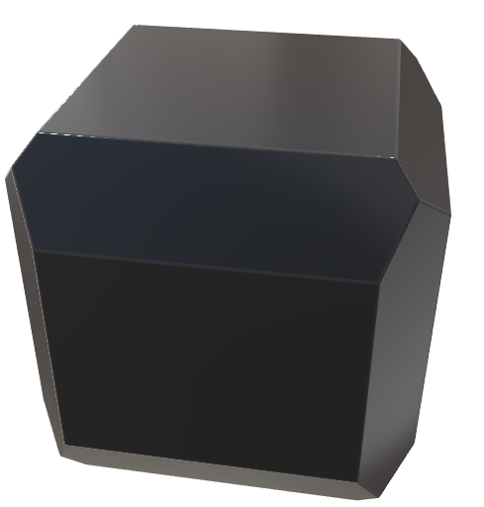
Input Flow
STT
Mic
Text
CV
Camera
JSON
Request
JSON
Sensors

Slide 19



Output Flow
TTS
Text
Speaker
Face
JSON
Display
Response
JSON
Hardware

Slide 20
Hardware
Structure
Of ALIF
ALIF’s body will mainly consist of a base (with omni-directional wheels), torso (to hold battery and microcontroller), arms with servos (at both sides) and a face with display and camera embedded.
Majority of the parts will be 3D-printed.

Slide 21
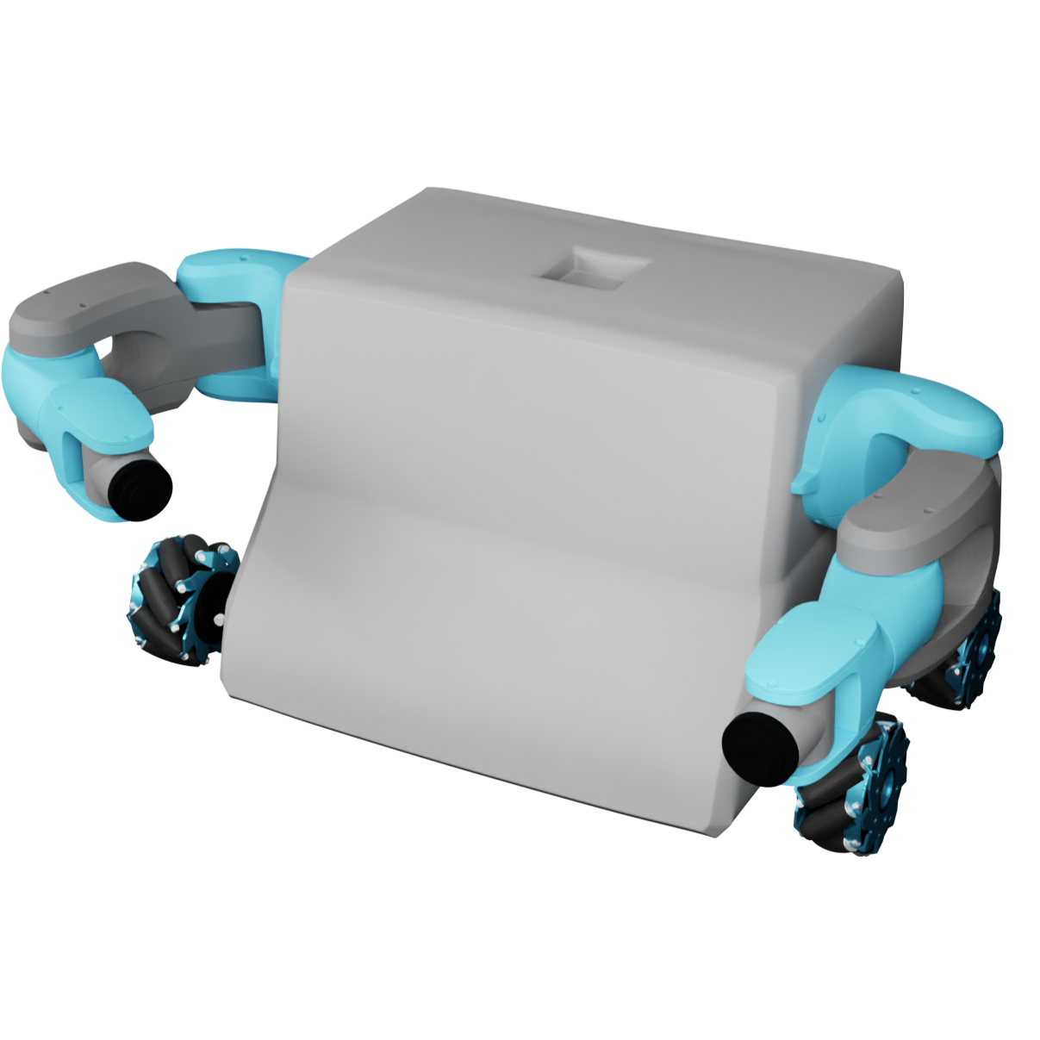

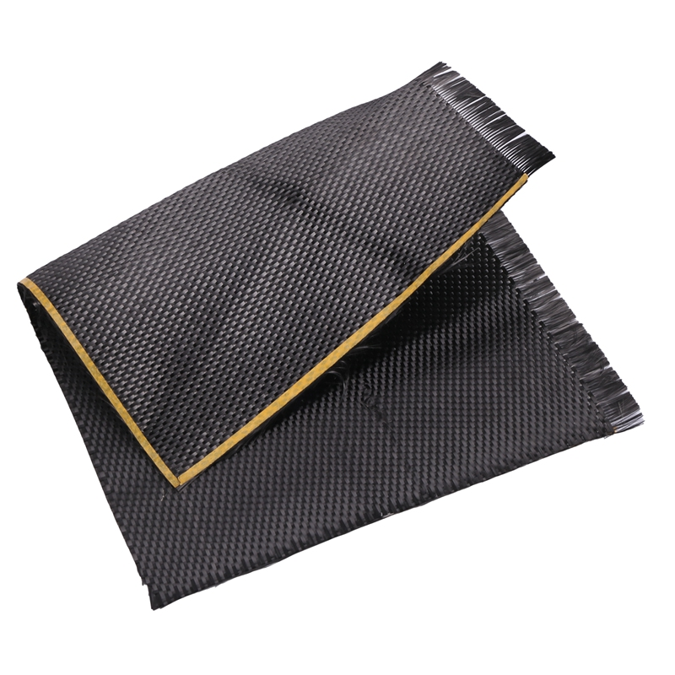
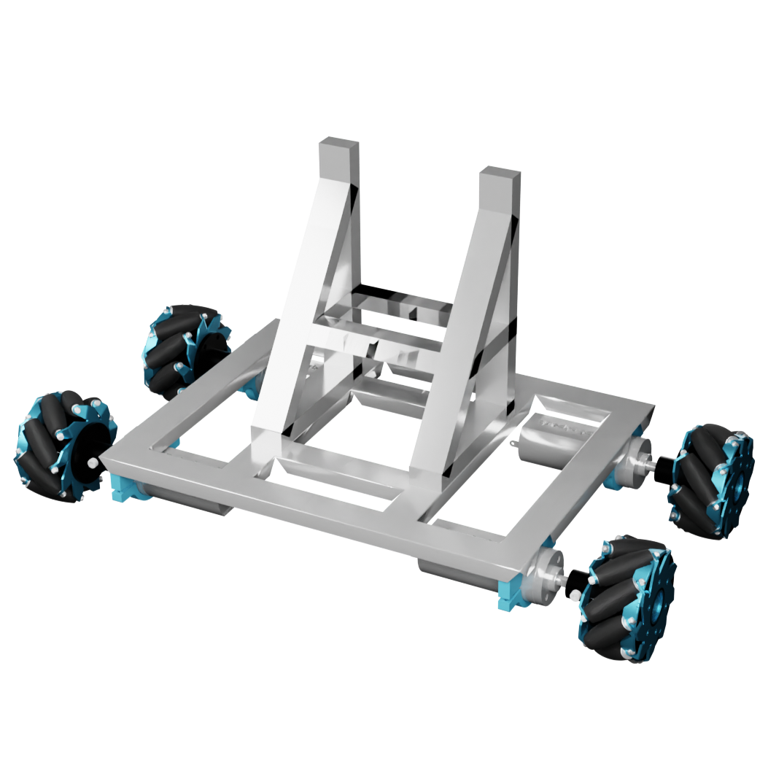

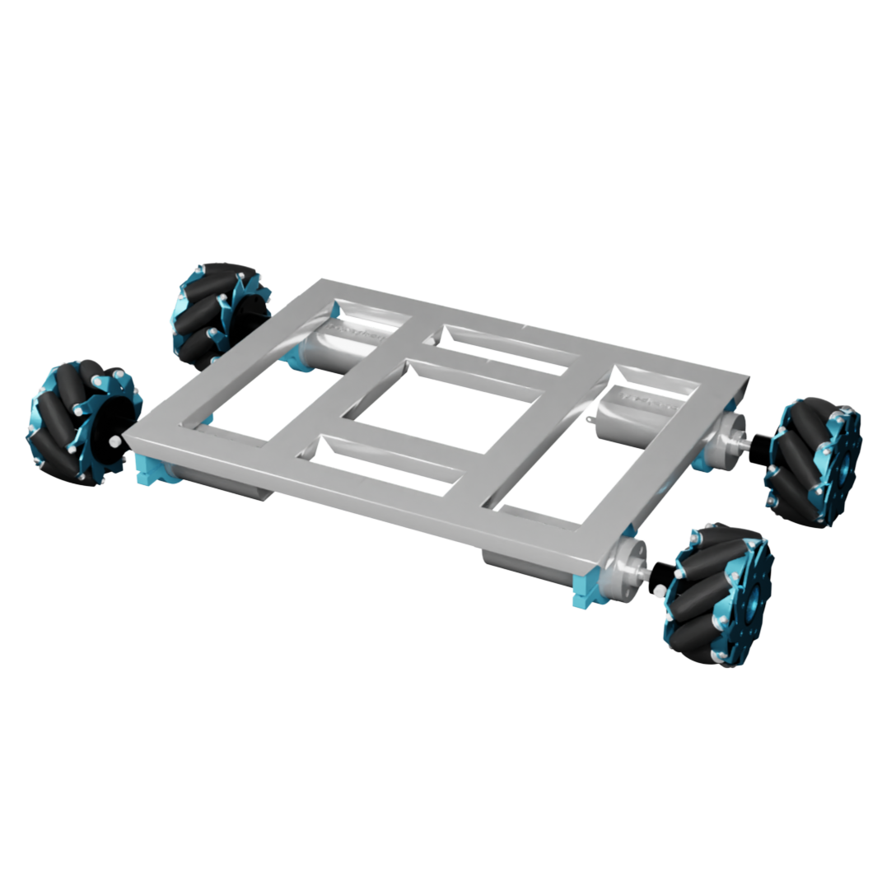


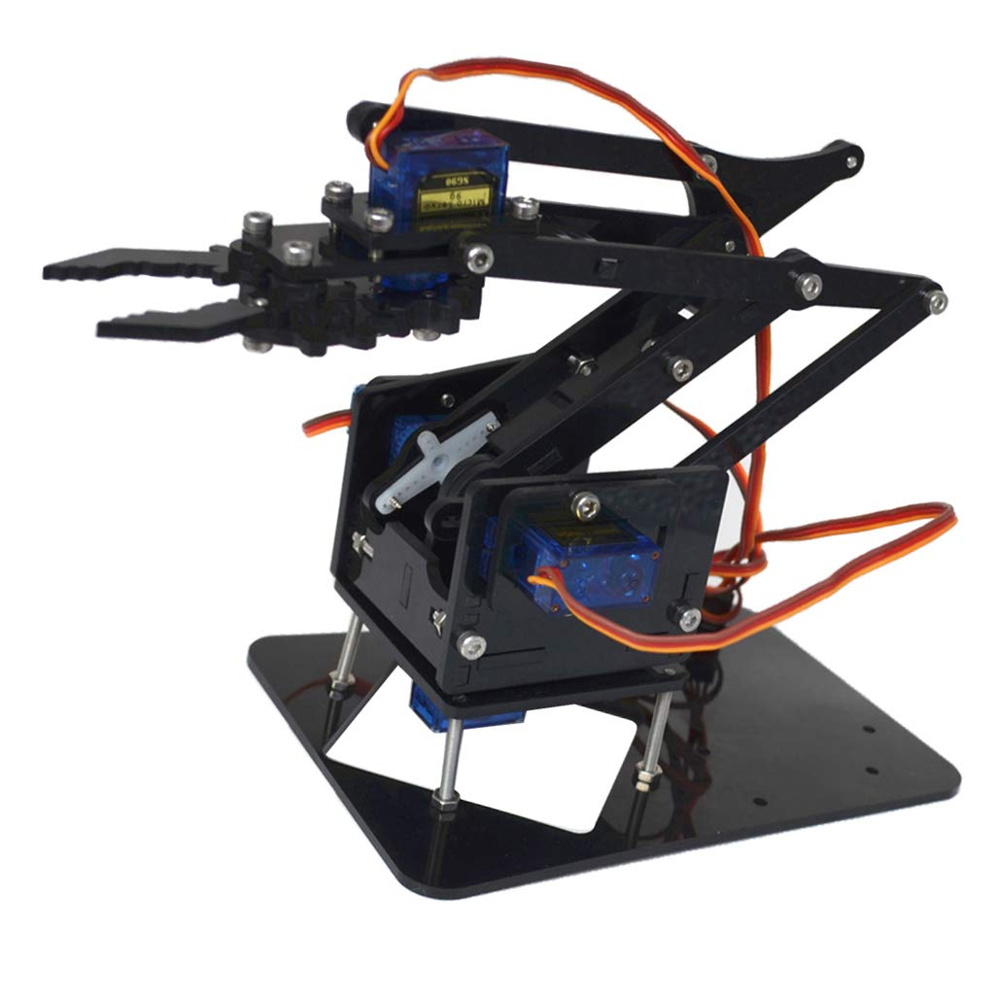
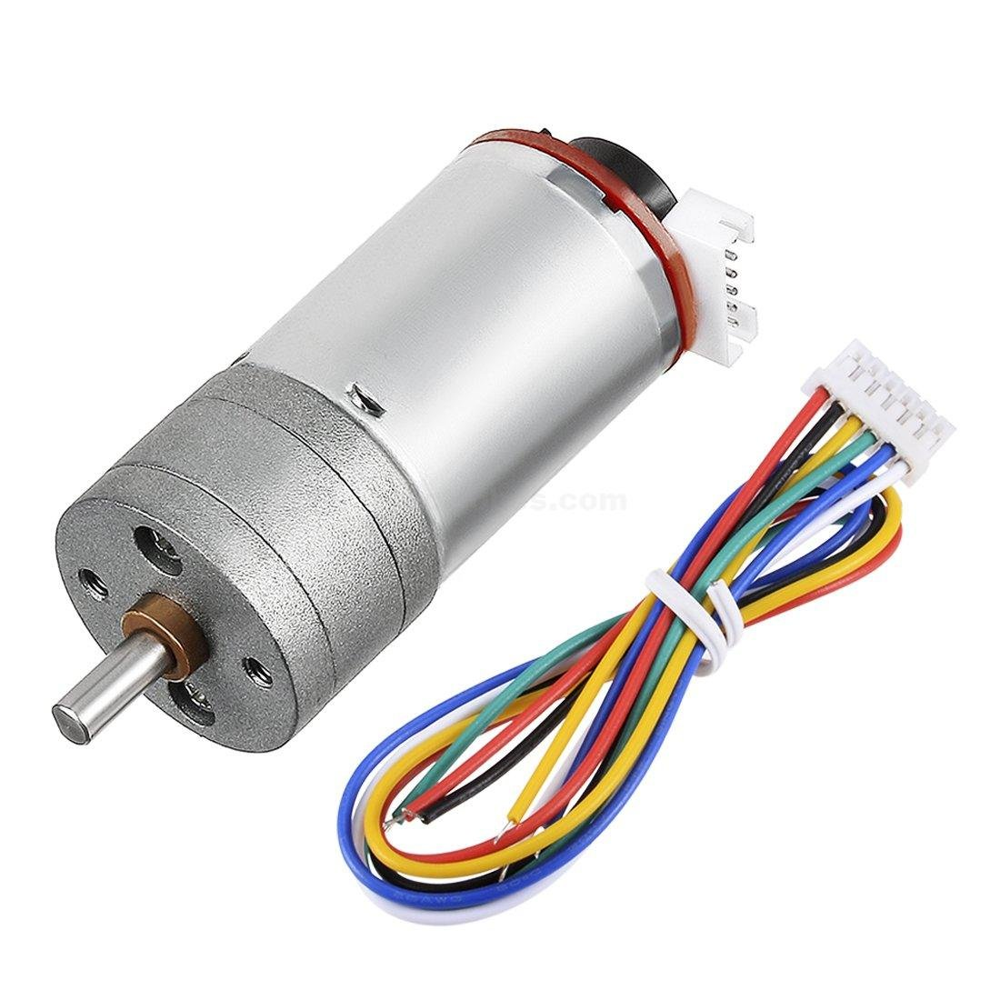
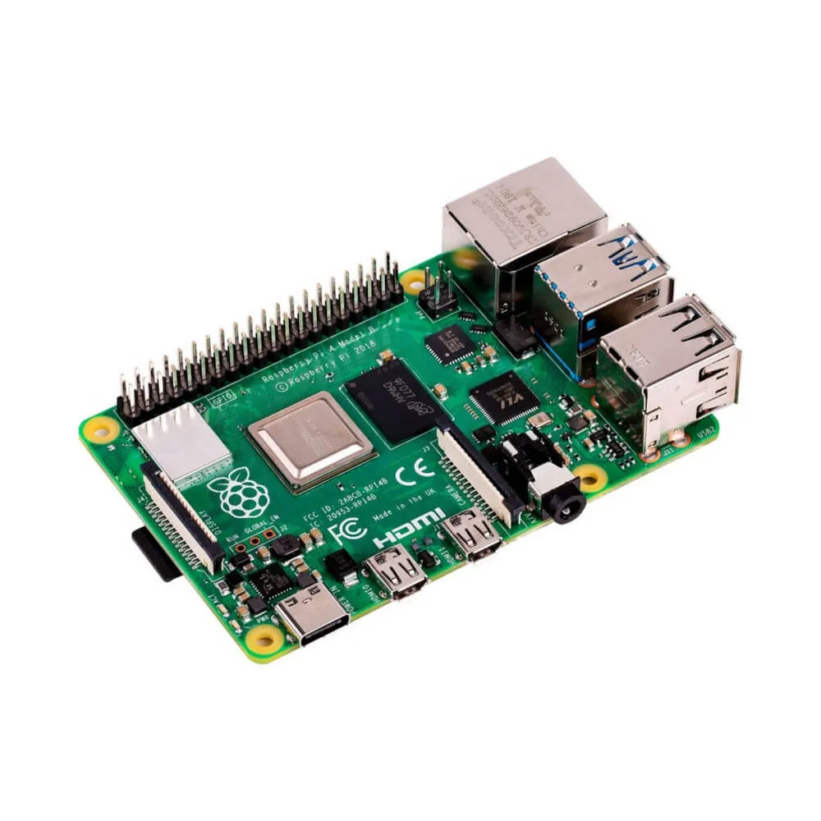
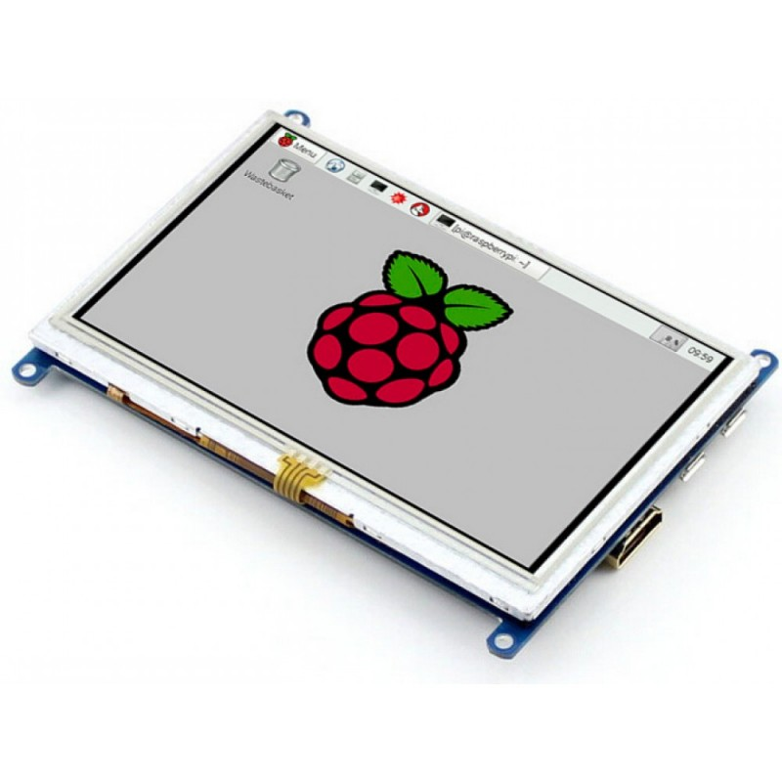
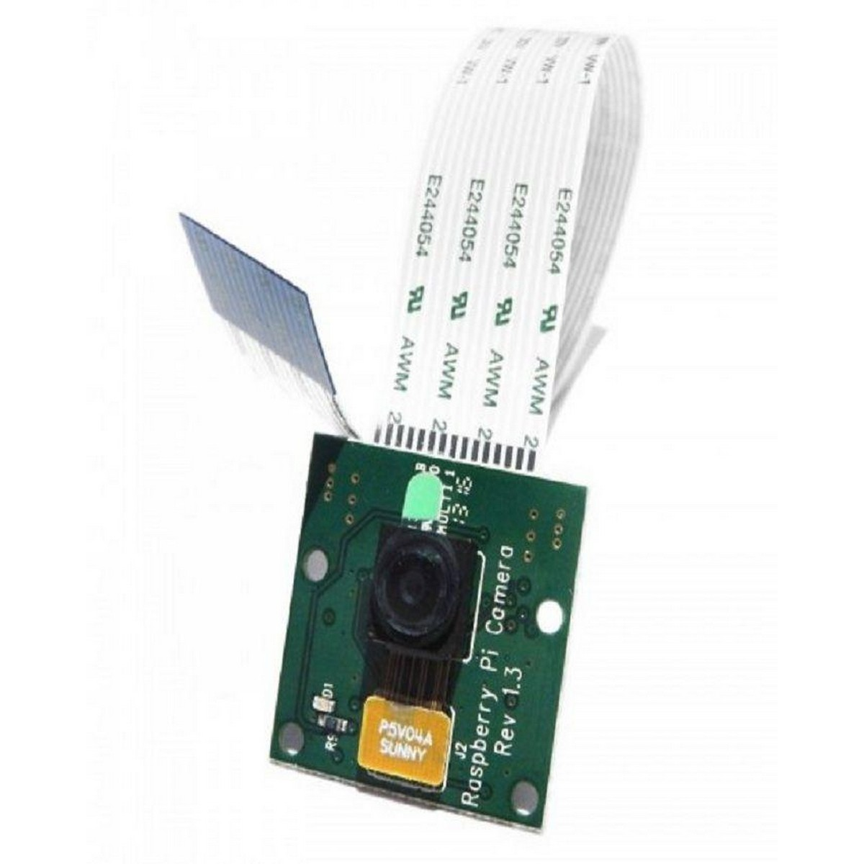

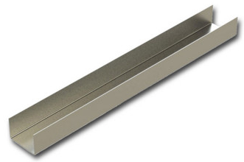
Hardware
Structure
Of alif
Lower Body
Torso
01
02
Face
Tyres
Chasis
Frame
Arms
Shell
04
Motors
03
Head
Limbs

Slide 22
Resume Screening and Analysis
Conduct Interviews
Report Generation
Facial Expression Rendering
Voice Communication
Gesture Recognition
Mobility
Learning and Adaptability
Decision Support
Functional Requirements
Non Functional Requirements

Slide 23
Performance / Speed
Scalability of Personalization
Accuracy of CV Screening
Ethical and Explainable AI in User Profiling
Environment Understanding Reliability
Efficiency in Task Execution
Resume Screening and Analysis
Conduct Interviews
Report Generation
Facial Expression Rendering
Voice Communication
Gesture Recognition
Mobility
Learning and Adaptability
Decision Support
Functional Requirements
Non Functional Requirements

Slide 24










Tools &
Technologies
Backend
Python
Raspberry Pi
API
AI-Models, TTS, STT, RPi
PHP
Bash
JSON
Web-Server, Emails, Queues
Linux CLI, Scripts, crontab
Web Server API
Frontend
Database
GraphQL
For Sockets
JavaScript (ES6)
SQL
ChartsJS, SweetAlerts
MySQL, users, devices & admin panel
TypeScript
Cypher
ReactJS with TS using Material UI
Neo4J Graph Database

Slide 25

















Frameworks
Libraries, Models and Components
Machine Learning & AI
Text to Speech (TTS)
Computer Vision
LLMs
eSpeak
YOLO
GPT2, DistilGPT2, DistilBERT, TinyGPT
lightweight offline TTS engine
Object Detection, User Profiling
Coqui
OpenCV
TTS for server
Image Processing
Speech Recognition (STT)
Web Development
APIs
SpeechRecognition
Laravel
Laravel API Resource
Python package supporting many engines
Server for both Pi & Admin Panel
API Server for Pi Devices
Fast API
Vosk
ReactJS
Python workers
Offline light weight SR engine
Frontend for Admin Panel
Whisper
STT Engine for Server (Offline)
Notes:
28

Slide 26
Conclusion

